Slide 1
Software Engineering Agile
CS 1530
Spring 2020
Instructor: Sohel Sarwar
University of Pittsburgh
Lecture 2

Slide 2
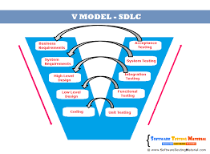
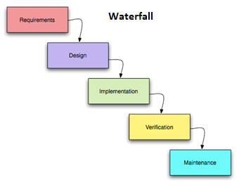
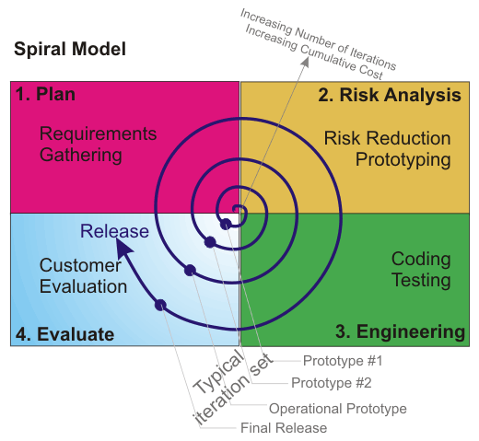
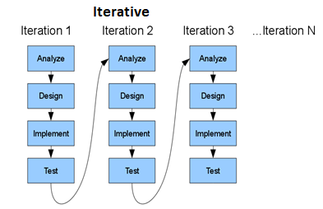
Software Development Methodologies
RECAP

Slide 3
Software Engineering Agile
What is Agile by Agile Alliance?
Agile is the ability to create and respond to change. It is a way of dealing with, and ultimately succeeding in, an uncertain and turbulent environment.
https://www.agilealliance.org/agile101/

Slide 4
Software Engineering Agile
What is Agile in a generic term?
Agile is a collection of software development methodologies, which adopts iterations and where requirements and solutions evolve incrementally overtime through collaboration among various stakeholders. The value proposition offered by Agile development includes faster product delivery with high degree of quality, predictability, nimble change management and adaptability.

Slide 5
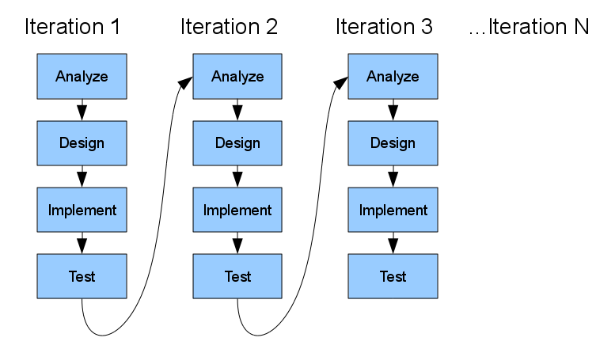

Software Engineering Agile

Slide 6
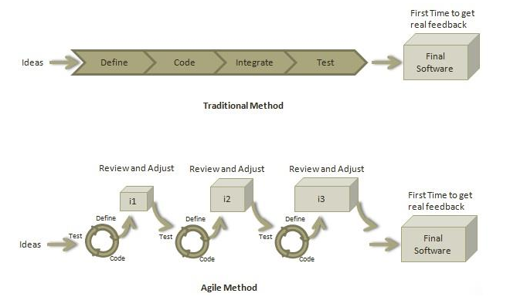
Software Engineering Agile

Slide 7
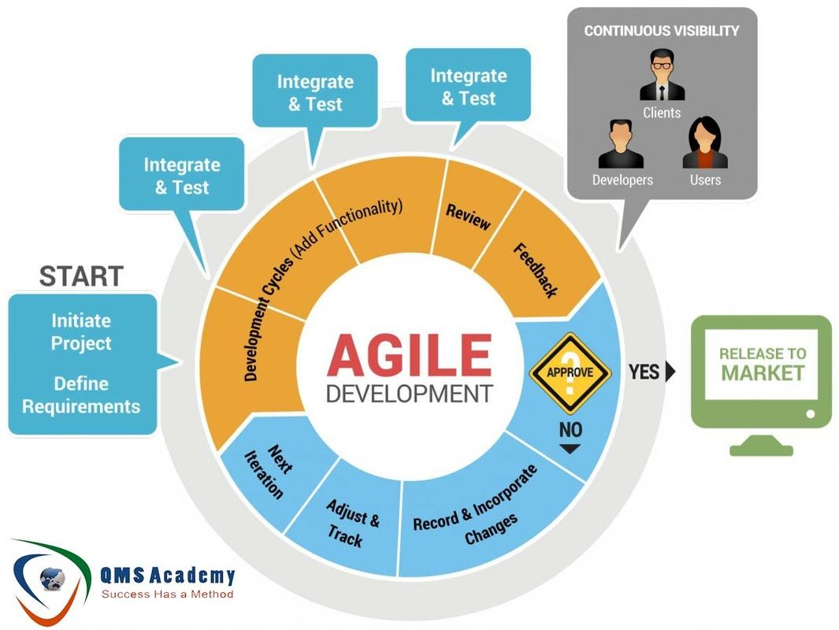
Software Engineering Agile

Slide 8
Software Engineering Agile
Various Key Points of Agile Development
Agile methods promote a number of engineering practices that enable cost effective change.
Author and speaker Martin Fowler describes testing and continuous integration as the “enabling” Agile practices that allow for the advantages gained, like rapid production and minimum up-front design.

Slide 9
Software Engineering Agile
Various Key Points of Agile Development
“Test driven development” is a quality-first approach where developer tests(called unit tests) are written prior to the functional code itself.
Rather than focusing a lot of effort on big upfront design analysis, small increments of functional code are produced according to immediate business need.
It is the role of the automated test suite built around the rapidly evolving code to act as a harness that allows developers to make aggressive code changes without fear of undetected regression failure.

Slide 10
Software Engineering Agile Flavors
SCRUM
XP (Extreme Programming)
KANBAN

Slide 11
Software Engineering Agile SCRUM
Scrum is a project management methodology. It was developed by Jeff Sutherland and Ken Schwaber in the early 90s.
In simple terms, Scrum breaks down organizations into small, self-organizing units based on roles. These SCRUM units collaborate to break the product features down into small, manageable items of work (called stories) which they tackle in time-boxed iterations called sprints.
Source: https://www.scrum.org/resources/blog/scrum-and-extreme-programming-xp

Slide 12
Software Engineering Agile SCRUM Artifacts
Sprint
A Sprint in Scrum is not a release cadence but a planning cadence.
Scrum allows you to choose the Sprint duration to be 2 weeks to one month
Scrum Team practicing XP will adjust the number of stories they pick per Sprint as they only work 40 hours per Sprint.
Source: https://www.scrum.org/resources/blog/scrum-and-extreme-programming-xp

Slide 13
Software Engineering Agile SCRUM Artifacts
Sprint 0
Also known as discovery sprint. Used to:
Find & document the scope and requirements of the overall project as visible at that stage
Produce Design Documents
Select Technology Stack
Source: https://www.scrum.org/resources/blog/scrum-and-extreme-programming-xp

Slide 14
Software Engineering Agile SCRUM Artifacts
What Are Agile User Stories?
A user story is the smallest unit of work in an agile framework. Usually, the features and functionalities are broken down into user stories. User stories are constructed with brief simple narratives explaining desired outcome, involved technicalities, and acceptance criteria.
In scrum, user stories are initially added to the Product Backlog. Afterwards, for a given Sprint, through Sprint Planning some of those are brought into the Sprint Backlog to be worked on. Also, during the Sprint Planning the stories are estimated in terms of points or man hours. With time and experience, Scrum teams become more efficient in work estimation and overall resource and timeline prediction.

Slide 15
Software Engineering Agile SCRUM Artifacts
What is an Agile Epic?
An epic is a large body of work that can be broken down into a number of smaller stories, or sometimes called “Issues” in Jira. Epics often encompass multiple teams, on multiple projects, and can even be tracked on multiple boards.
Epics are almost always delivered over a set of sprints. As a team learns more about an epic through development and customer feedback, user stories will be added and removed as necessary. That’s the key with agile epics: Scope is flexible, based on customer feedback and team cadence.
Ref: https://www.atlassian.com/agile/project-management/epics

Slide 16
Software Engineering Agile SCRUM Artifacts
Product Backlog
Scrum requires the Product Backlog to be transparent as it is the single source of truth for any changes made to the product. XP teams write User Story. Writing the Product Backlog in stories is helpful for the team because stories is from the user perspective.

Slide 17
Software Engineering Agile SCRUM Artifacts
Sprint Backlog
The Sprint Backlog is user stories selected during Sprint Planning along with the tasks to complete those stories. The Sprint Backlog is a one week worth of work for the Development Team. Scrum Team may have other tasks that are not related to the selected stories in their Sprint Backlog.

Slide 18
Software Engineering Agile SCRUM Artifacts
Definition of Done
Scrum does not tell us how the definition of done looks like. For some people that is quite confusing. That is why some people even think that the Acceptance Criteria is the definition of "Done". Scrum just tell us that the increment delivered by the development team to be "Done" every Sprint, and done means meeting the Scrum Team's definition of "Done".

Slide 19
Software Engineering Agile SCRUM Teams
Within the Scrum Framework three roles are defined:
The Scrum Team
Scrum Master
Scrum Product Owner
Each of these roles has a defined set of responsibilities and only if they fulfill these responsibilities, closely interact and work together they can finish a project successfully.
Source: https://www.scrum-institute.org/Scrum_Roles_The_Scrum_Team.php

Slide 20
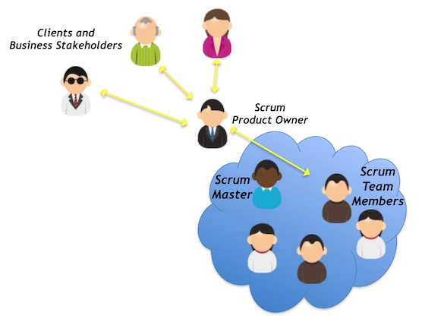
Software Engineering Agile SCRUM Teams
Source: https://www.scrum-institute.org/Scrum_Roles_The_Scrum_Team.php

Slide 21
Software Engineering Agile SCRUM Roles
The Scrum Team
Within the Scrum Framework all work delivered to the customer is done by dedicated Scrum Teams. A Scrum Team is a collection of individuals working together to deliver the requested and committed product increments. Usually, a SCRUM team is comprised of developers, testers, and designers.
Within the Scrum Framework all work delivered to the customer is done by dedicated Scrum To work effectively it is important for a Scrum Team that everyone within the team
follows a common goal
adheres the same norms and rules
shows respect to each other
Source: https://www.scrum-institute.org/Scrum_Roles_The_Scrum_Team.php

Slide 22
Software Engineering Agile SCRUM Roles
The Scrum Master
The Scrum Master is responsible for promoting and supporting Scrum. Scrum Masters do this by helping everyone understand Scrum theory, practices, rules, and values.
The Scrum Master is a servant-leader for the Scrum Team. The Scrum Master helps those outside the Scrum Team understand which of their interactions with the Scrum Team are helpful and which aren’t. The Scrum Master helps everyone change these interactions to maximize the value created by the Scrum Team.
Source: https://www.scrum.org/resources/what-is-a-scrum-master

Slide 23
Software Engineering Agile SCRUM Roles
The Scrum Master
The tasks of a Scrum Master are as followings:
Ensuring that goals, scope, and product domain are understood by everyone on the Scrum Team as well as possible.
Finding techniques for effective Product Backlog management.
Understanding product planning in an empirical environment.
Understanding and practicing agility.
Source: https://www.scrum.org/resources/what-is-a-scrum-master

Slide 24
Software Engineering Agile SCRUM Roles
The Scrum Master
The tasks of a Scrum Master are as followings (continued):
Facilitating Scrum events as requested or needed.
Coaching the Development Team in self-organization and cross-functionality.
Helping the Development Team to create high-value products.
Removing impediments to the Development Team’s progress.
Source: https://www.scrum.org/resources/what-is-a-scrum-master

Slide 25
Software Engineering Agile SCRUM Roles
Product Owner
A Scrum Product Owner is responsible for project evaluation, initiation, development, and marketing.
S/he maximizes the value of the product resulting from the work of the Development Team.
The Product Owner is the sole person responsible for managing the Product Backlog.
The Product Owner is one person, not a committee.
For the Product Owner to succeed, the entire organization must respect his or her decisions. The Product Owner’s decisions are visible in the content and ordering of the Product Backlog. No one can force the Development Team to work from a different set of requirements.
Source: https://www.scrum.org/resources/what-is-a-product-owner

Slide 26
Software Engineering Agile SCRUM Events
There are also four prescribed meetings in Scrum:
Sprint Planning Meeting
Daily Stand Up
Sprint Review
Sprint Retrospective
Source: https://www.scrum.org/resources/blog/scrum-and-extreme-programming-xp

Slide 27
Software Engineering Agile SCRUM Events
Sprint Planning
Scrum does not mandate the usage of Planning Poker and Story Points. Scrum Team is free to choose how they want to estimate. In fact, Scrum team is allowed to estimate in hours if they wish for that particular Sprint.
Scrum Team who is practicing XP will do Planning with Story Points every Sprint Planning.
During Sprint Planning the Development Team will break these stories into tasks that will be done by the whole Development Team.
Source: https://www.scrum.org/

Slide 28
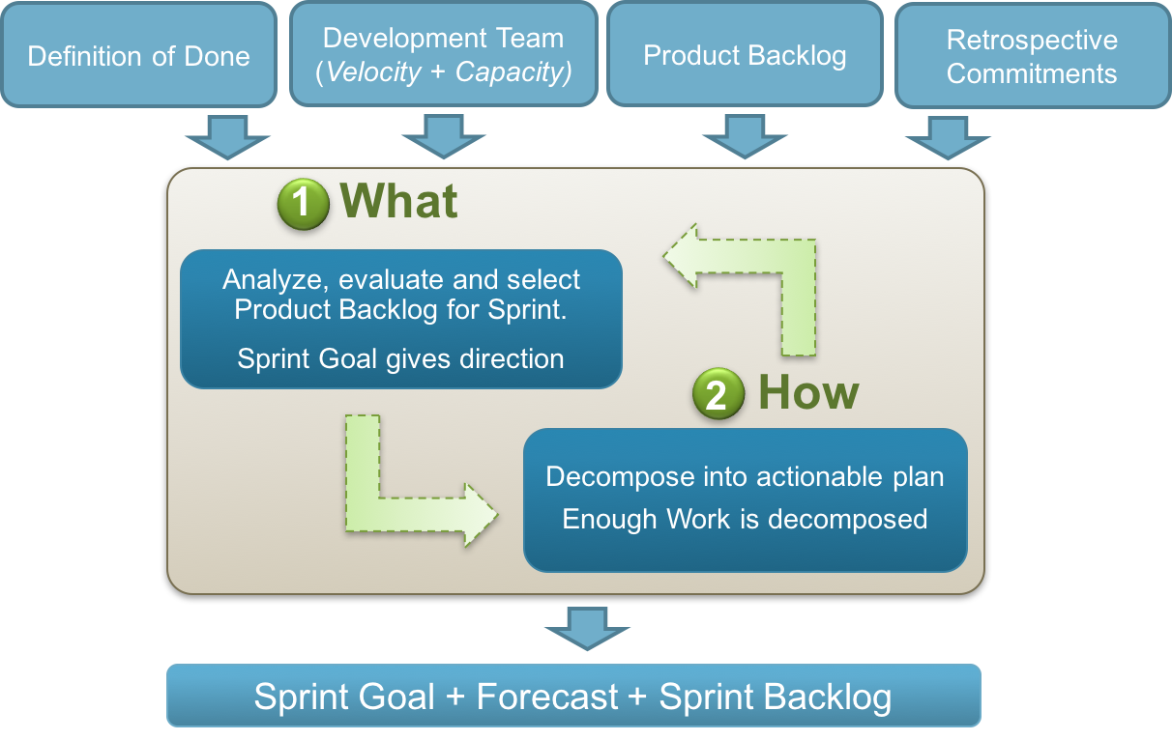
Software Engineering Agile SCRUM Events
Sprint Planning Workflow
Source: https://www.scrum.org/

Slide 29
Software Engineering Agile SCRUM Events
Daily SCRUM or Stand-Up
Daily Scrums improve communications, eliminate other meetings, identify impediments to development for removal, highlight and promote quick decision-making, and improve the Development Team’s level of knowledge. This is a key inspect and adapt meeting.
Daily SCRUM is not a Conventional Status Meeting
https://www.scrum.org/resources/what-is-a-daily-scrum

Slide 30
Software Engineering Agile SCRUM Events
Daily SCRUM or Stand-Up
The Daily Scrum is a 15-minute time-boxed event for the Development Team to synchronize activities and create a plan for the next 24 hours. The Daily Scrum is held every day of the Sprint. At it, the Development Team plans work for the next 24 hours. This optimizes team collaboration and performance by inspecting the work since the last Daily Scrum and forecasting upcoming Sprint work. The Daily Scrum is held at the same time and place each day to reduce complexity.
https://www.scrum.org/resources/what-is-a-daily-scrum

Slide 31
Software Engineering Agile SCRUM Events
Sprint Review
The accumulation of the story points for every story completed during the Sprint is called the velocity. During Sprint Review the Scrum Team will calculate the velocity. For some teams using velocity is useful to forecast the future development and also to predict how many PBI (Product Backlog Item) the team gauge every Sprint Planning.
Source: https://www.scrum.org/resources/blog/scrum-and-extreme-programming-xp

Slide 32
Software Engineering Agile SCRUM Events
Sprint Review
For Scrum Team practicing XP, during Sprint Review the customer, Product Owner and Development Team will review the product that is already in production.
The Sprint Review will not be the first time the Product Owner and the customer has seen the product.
Scrum Team will assess what is possible for the next week Sprint based on what has already been delivered to production
Source: https://www.scrum.org/resources/blog/scrum-and-extreme-programming-xp

Slide 33
Software Engineering Agile SCRUM Events
Sprint Retrospective
The Sprint Retrospective is an opportunity for the Scrum Team to inspect itself and create a plan for improvements to be enacted during the next Sprint.
The Sprint Retrospective occurs after the Sprint Review and prior to the next Sprint Planning. This is at most a three-hour meeting for one-month Sprints. For shorter Sprints, the event is usually shorter. The Scrum Master ensures that the event takes place and that attendants understand its purpose. This is the opportunity for the Scrum Team to improve and all member should be in attendance.
Source: https://www.scrum.org/resources/what-is-a-sprint-retrospective

Slide 34
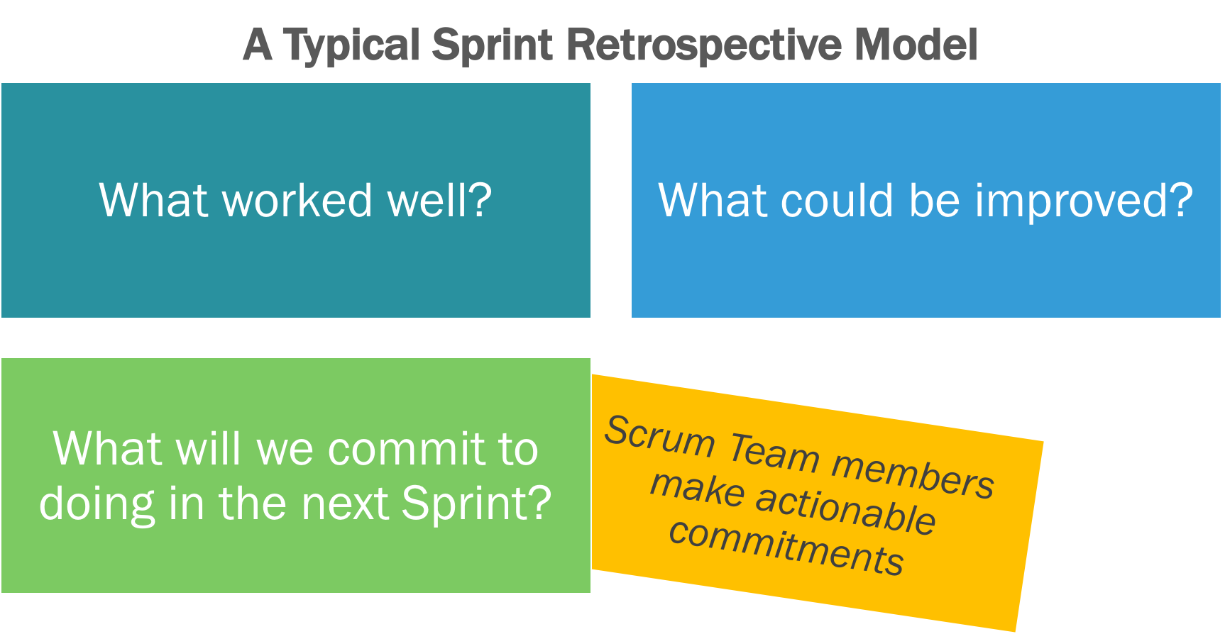
Software Engineering Agile SCRUM Events
Sprint Retrospective
During the Sprint Retrospective, the team discusses:
What went well in the Sprint
What could be improved
What will we commit to improve in the next Sprint
Source: https://www.scrum.org/resources/what-is-a-sprint-retrospective

Slide 35
Software Engineering Agile SCRUM Events
Sprint Retrospective
The Scrum Master encourages the Scrum Team to improve its development process and practices to make it more effective and enjoyable for the next Sprint. During each Sprint Retrospective, the Scrum Team plans ways to increase product quality by improving work processes or adapting the definition of “Done” if appropriate and not in conflict with product or organizational standards.
Source: https://www.scrum.org/resources/what-is-a-sprint-retrospective

Slide 36
Software Engineering Agile SCRUM Events
Sprint Retrospective
By the end of the Sprint Retrospective, the Scrum Team should have identified improvements that it will implement in the next Sprint. Implementing these improvements in the next Sprint is the adaptation to the inspection of the Scrum Team itself. Although improvements may be implemented at any time, the Sprint Retrospective provides a formal opportunity to focus on inspection and adaptation.
Source: https://www.scrum.org/resources/what-is-a-sprint-retrospective

Slide 37
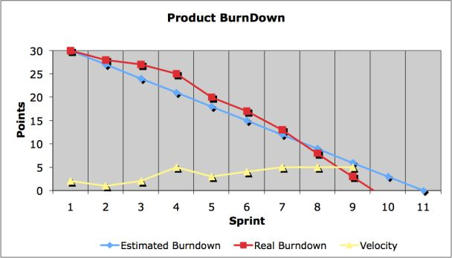
Software Engineering Agile Metrics
Source: https://www.scrum.org/resources/blog/scrum-and-extreme-programming-xp

Slide 38
Software Engineering Agile Metrics
Sprint burndown
Scrum teams organize development into time-boxed sprints. At the outset of the sprint, the team forecasts how much work they can complete during a sprint. A sprint burndown report then tracks the completion of work throughout the sprint. The x-axis represents time, and the y-axis refers to the amount of work left to complete, measured in either story points or hours. The goal is to have all the forecasted work completed by the end of the sprint.
Ref.: https://www.atlassian.com/agile/project-management/metrics

Slide 39
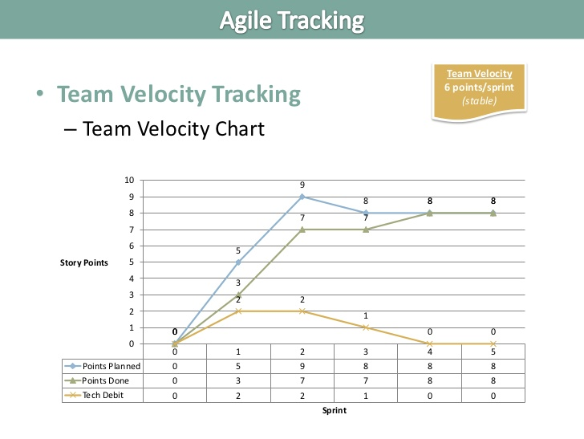
Software Engineering Agile Metrics
Source: https://www.scrum.org/resources/blog/scrum-and-extreme-programming-xp

Slide 40
Software Engineering Agile Metrics
Velocity
Velocity is the amount of work, measured in terms of story points or man hours, that a scrum team completes during a sprint. If we collect velocity data points over several sprints, we can plot the velocity chart, which can show the trend of the velocity. The velocity chart can provide some forecast about future sprint team performance.

Slide 41
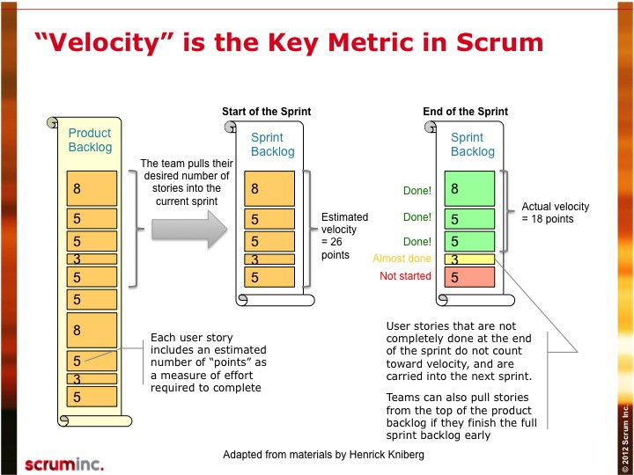
Software Engineering Agile Metrics
Source: https://www.scrum.org/resources/blog/scrum-and-extreme-programming-xp

